Slide 1
Impresario GIT usage

Slide 2
For GIT manager
Clone
Branch
Fetch
Merge
Push

Slide 3
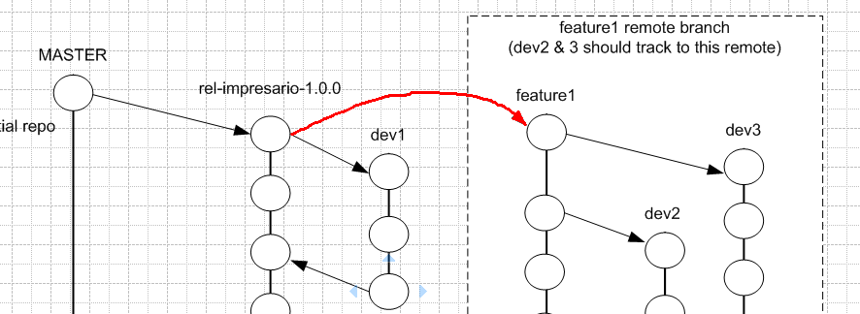
GIT clone
git clone --branch rel-impresario-1.0.0 impresario-remote impresario-local
After clone, we will have a repository named impresario-local with branch
rel-impresario-1.0.0

Slide 4



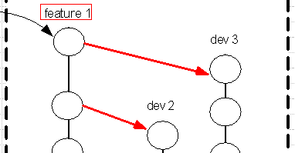
branch
Show local branches
Show all branches
Rename a branch
Create new branch from original branch
Delete a branch

Slide 5
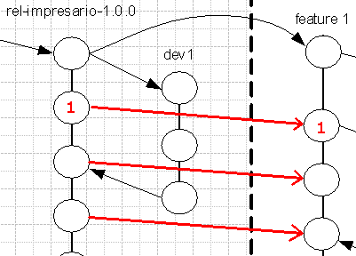
Fetch/merge
On local server, run git fetch origin then run
git merge origin/rel-impresario-1.0.0
If have any conflicts, must edit conflict files.
Then commit to commit 1 in local by command
git commit –a –m “message”

Slide 6
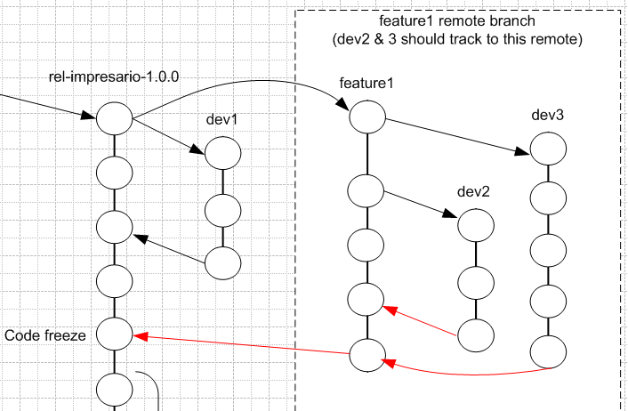
Push
git push origin --set-upstream
refs/remotes/origin/rel-impresario-1.1.0
Before use git push, must be fetch the newest from remote.

Slide 7
For DEV
checkout
clone (same as above)
add
commit
rebase
merge
fetch
status
log
diff
config

Slide 8
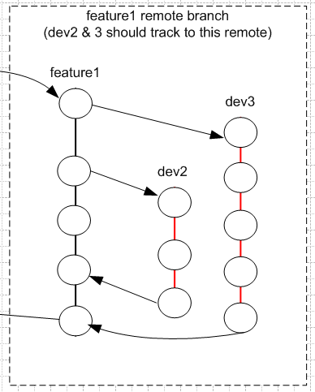
commit
Purpose:
when:
how:

Slide 9
Default config
User.name → Core ID
User.email → FSL email
push.default → upstream (push the current branch to its upstream branch.)

